Slide 1
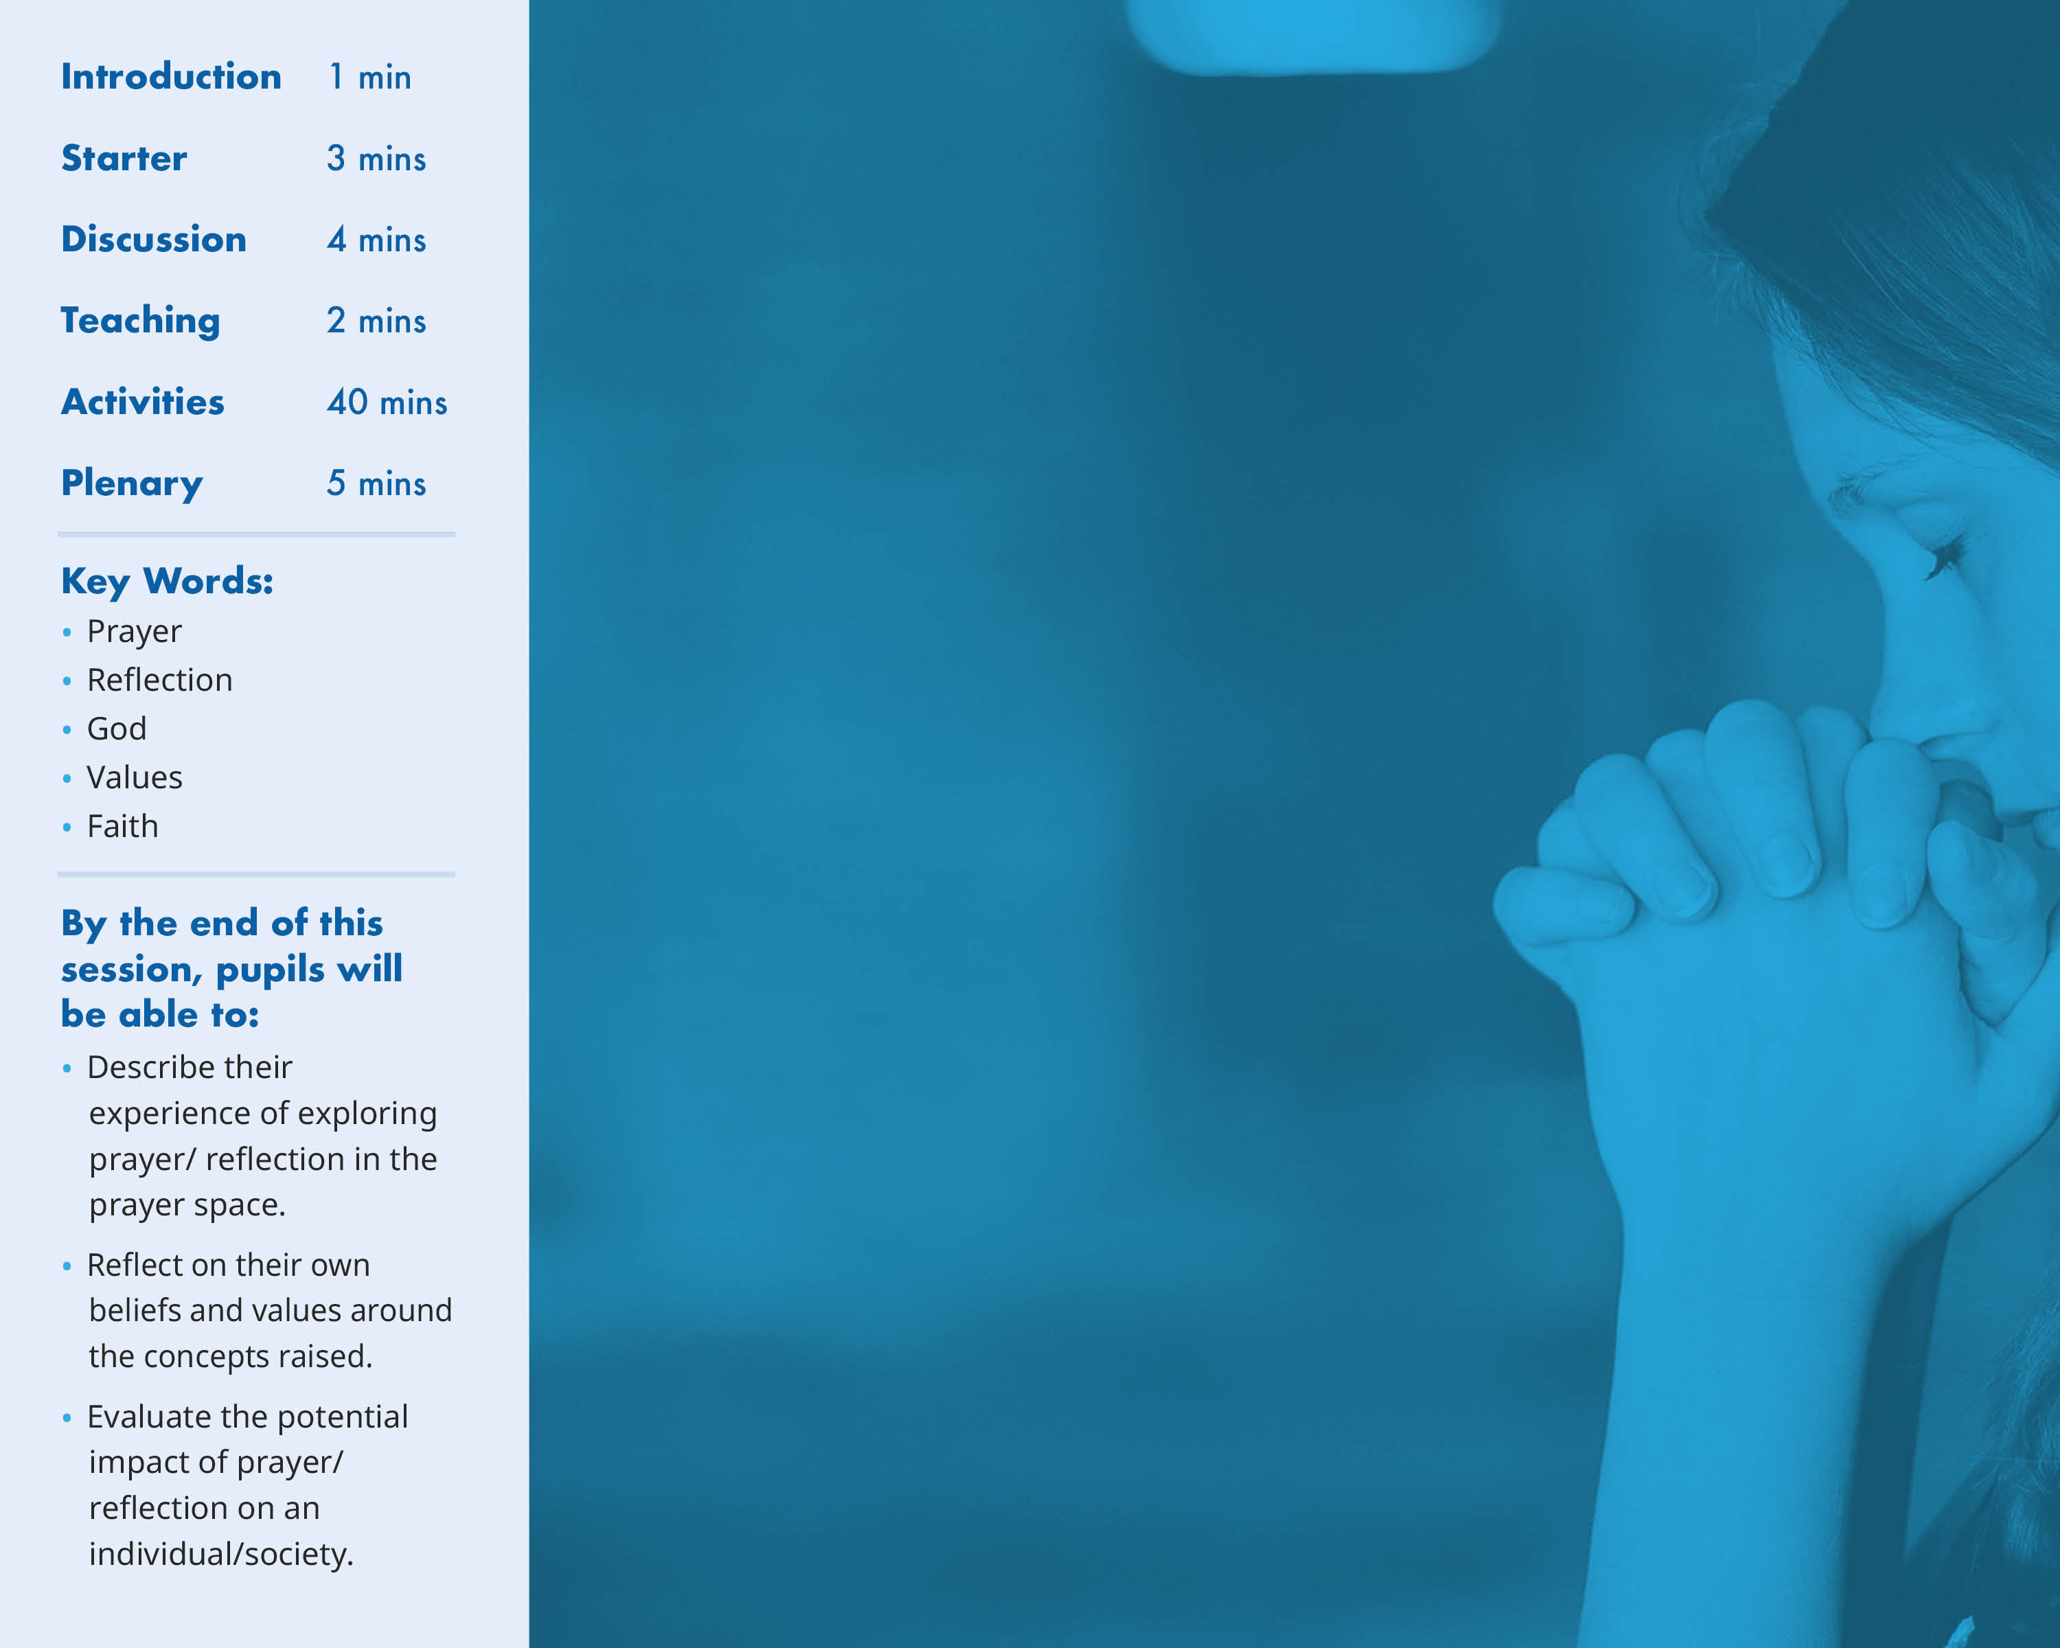
I am…
I am here from…
The reason I am here is…

Slide 2
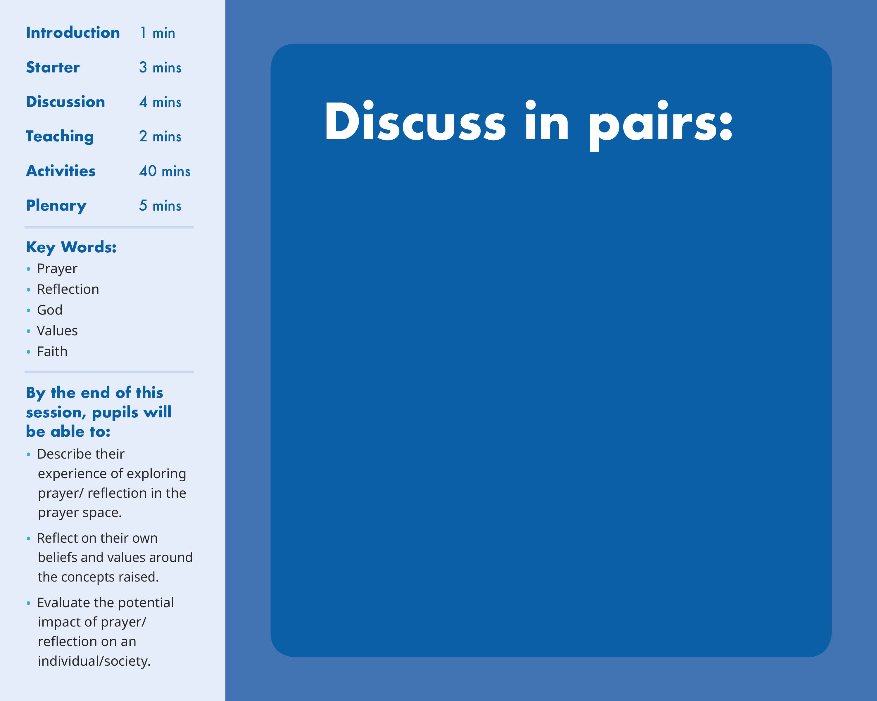

What is prayer – can you form a simple definition?
Think of 3 situations in which someone - whether religious or not - might pray
How might someone pray?
Think about location, posture, rituals, symbols…

Slide 3
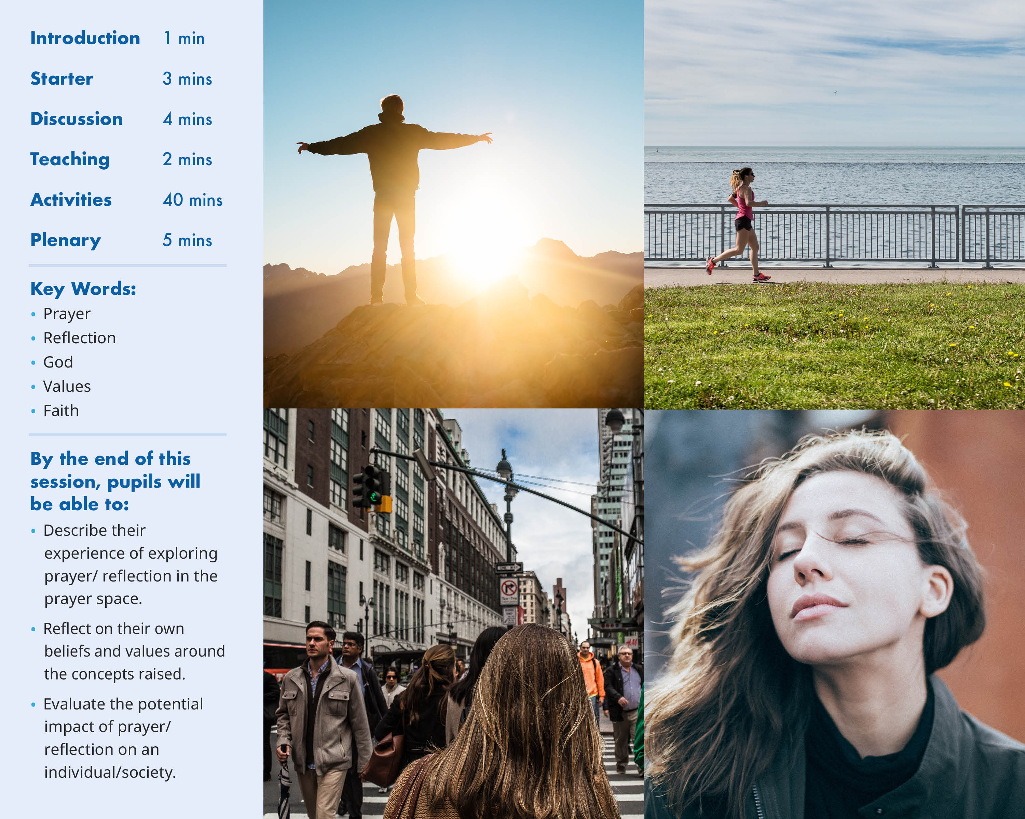

Slide 4
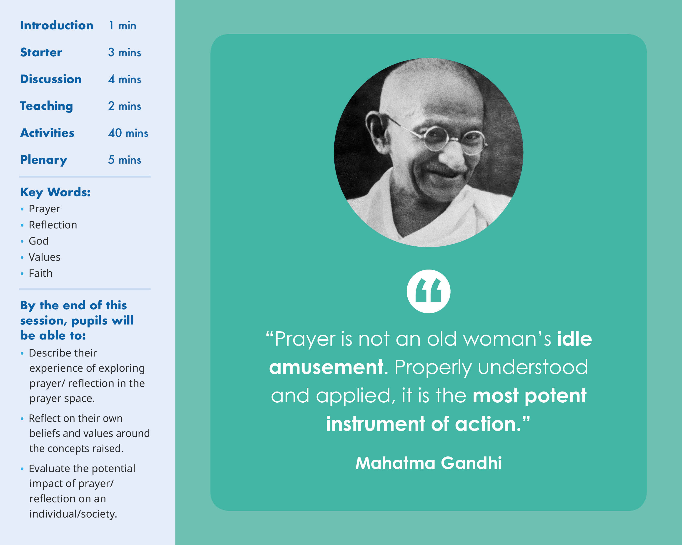

Slide 5
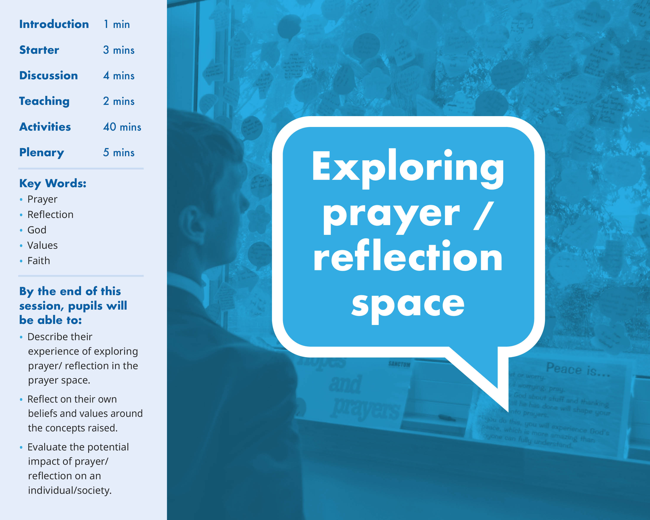

Slide 6
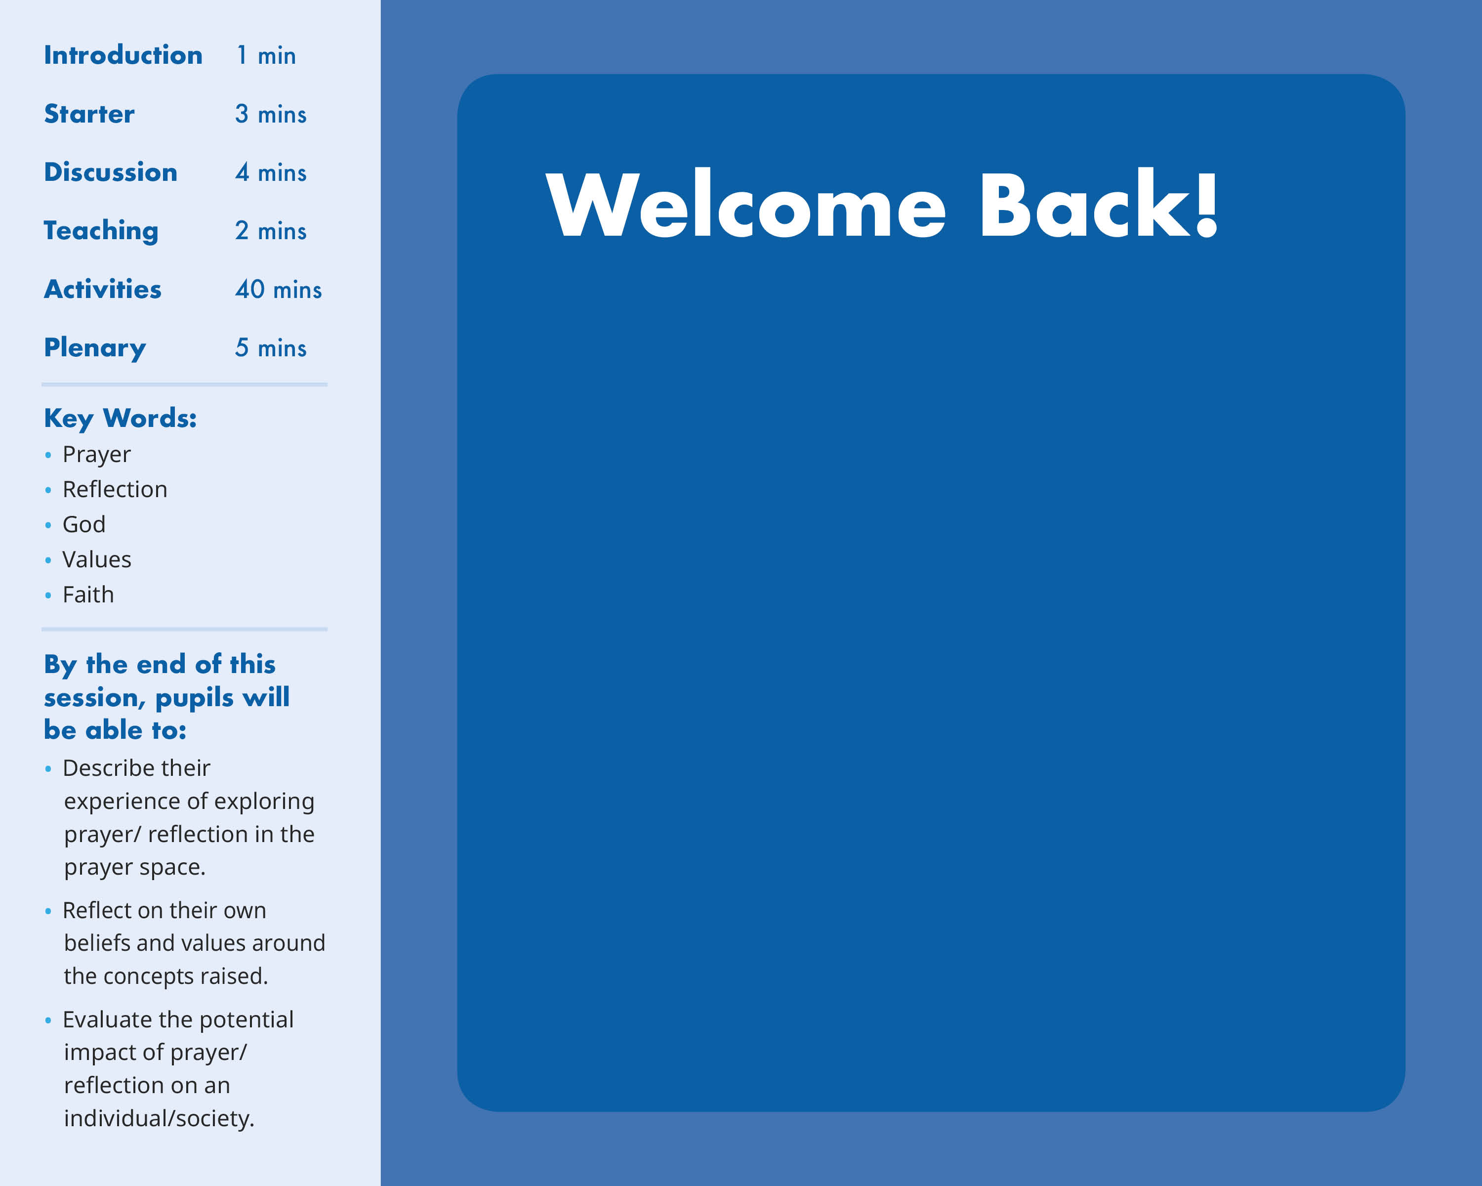
Which activity did you most enjoy/why?
Which did you find most challenging/why?
What did you learn about yourself or your own beliefs and values?
How might prayer or reflection benefit people of faith or of no faith?

